Slide 1
Lesson Six- Solution of Systems of Linear Equations

Slide 2
6.1 Introduction
In the previous lesson we looked at
finding inverses of a matrix using row reduction method,
the general concept of reducing a matrix to echelon form
and the concept of the canonical (reduced row echelon) form of a matrix.

Slide 3
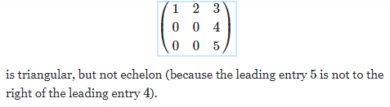


Recall that each leading row entry should be in a column to the right of the leading row entry above it. E.g.

Slide 4
This lesson starts with a general introduction to the solution of a system of linear equations, followed by a more detailed section on the solution of equations using Gauss Jordan method.
Other methods will follow in subsequent lessons i.e. Cramer's Rule and using inverse matrix

Slide 5
6.2 Learning Outcomes
By the end of this lesson, you will be able to solve a system of linear equations using Gauss Jordan method and you will be introduced to the other methods.

Slide 6
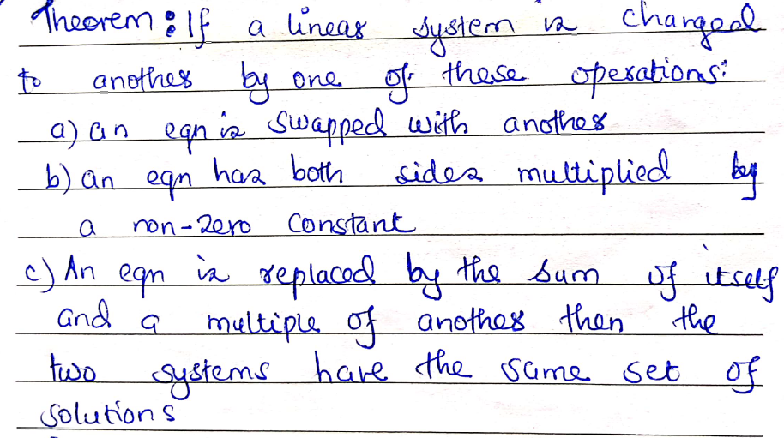
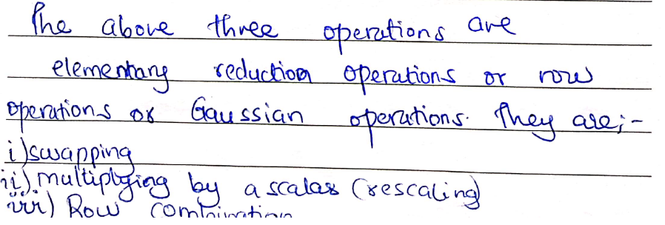

Slide 7
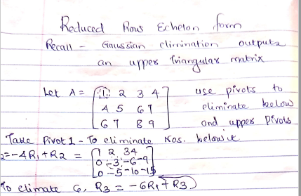

Slide 8
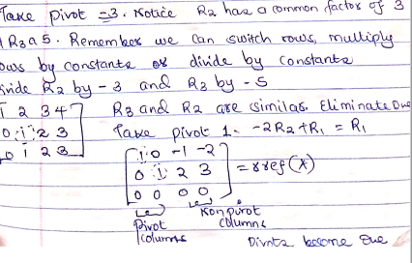

Slide 9
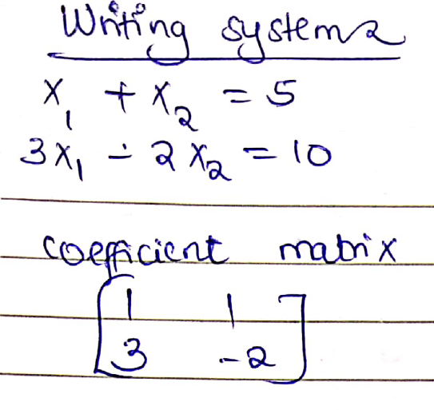
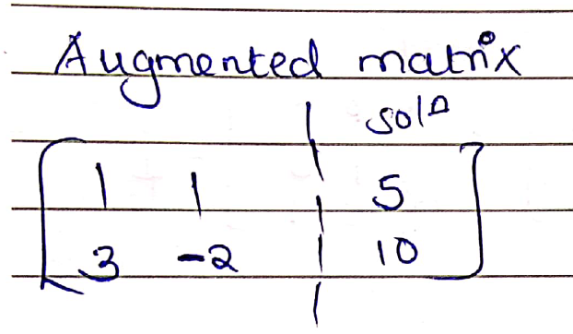

Slide 10
Simultaneous Equation. How can we combine the two equations? Multiply equation i by 2 to get
2x₁ + 2x₂ = 10
3x₁ – 2x₂ = 10
5x₁ = 20 therefore x₁ = 4;
Substitute x₁ in equation one to get 4 +x₂ = 5 therefore x₂ =1
Row reduction
R1 = 2R1 + R2
R1 = ⅕R1
R2 = 3R1-R2
R2=-1/2R2 1 0 4 x₁=4
0 1 1 x₂ =1

Slide 11
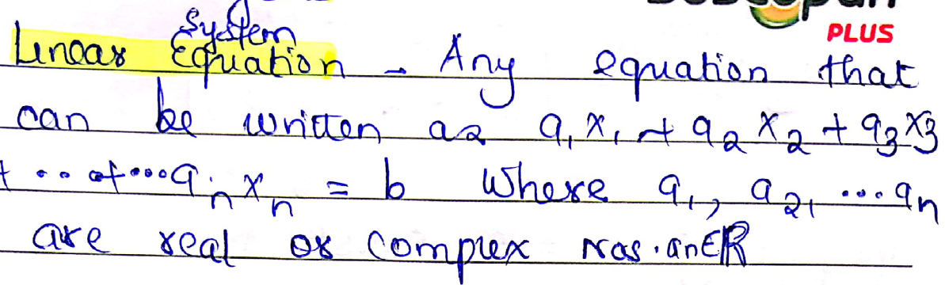

Slide 12
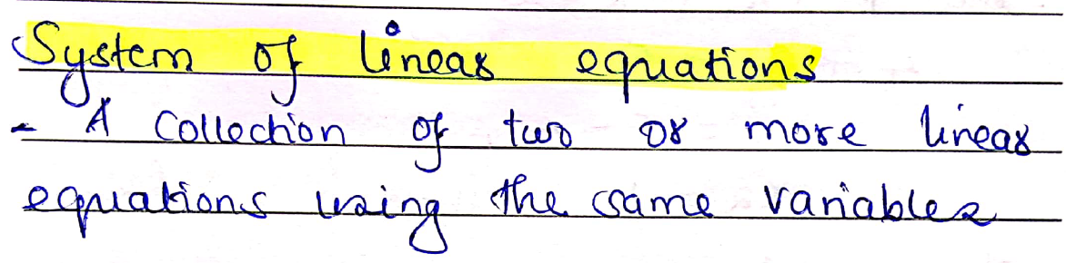

Slide 13
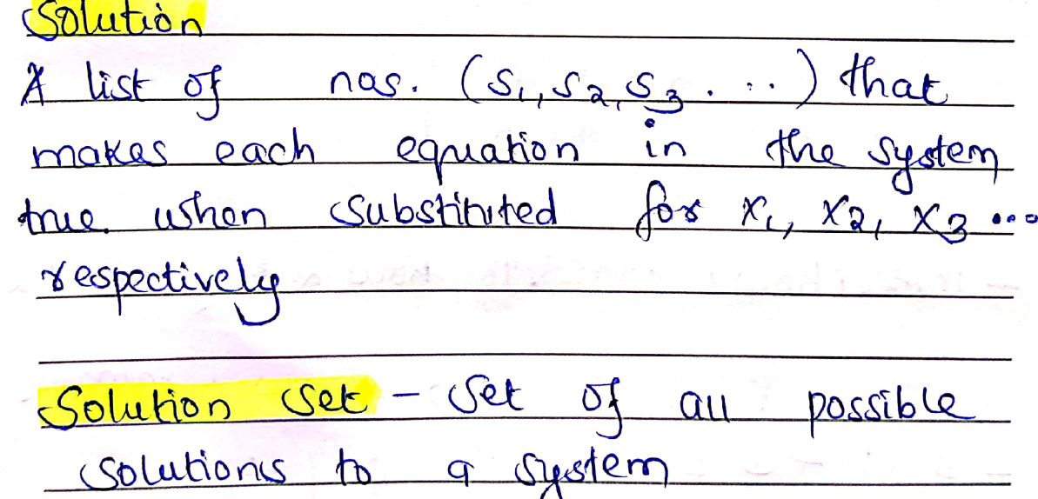

Slide 14
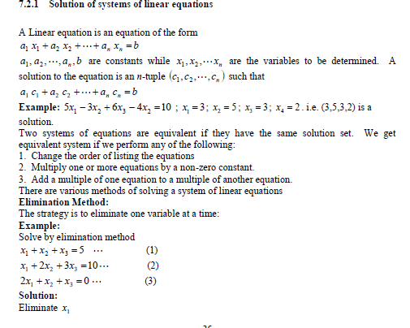

Slide 15
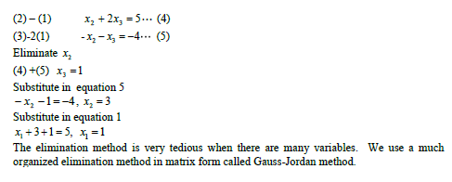
Change -4 to -10
Solution is X₁=-5, X₂=15, X₃=-5

Slide 16
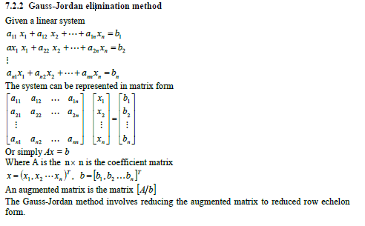
(GAUSS-JORDAN METHOD)

Slide 17
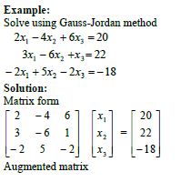

Slide 18
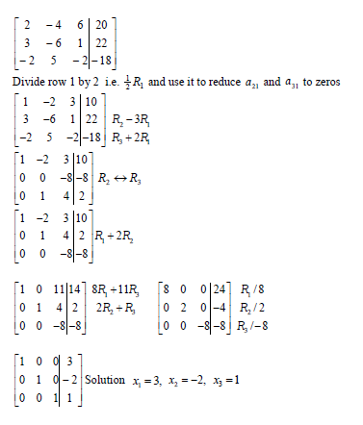

Slide 19
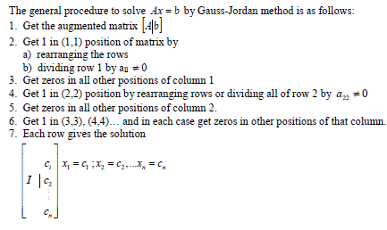
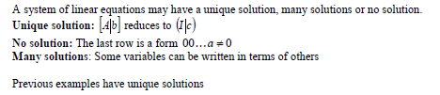

Slide 20
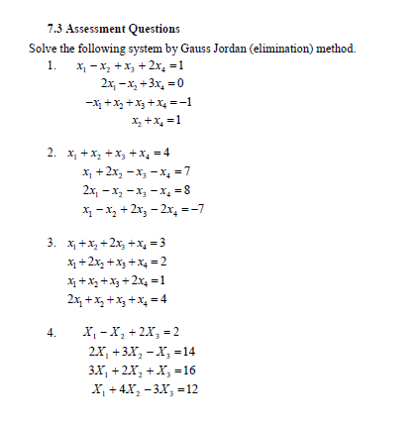

Slide 21
Questions? Comments?

